Slide 1





CLUB AUTOMATION
ROBOTICS CLUB, IIT KANPUR
presents
A Sci-Tech Summer Camp Project

Slide 2



What the project is about…..
--To automate various parts of Robotics Club Room, like lights, fans, switches etc., and develop a user interface and web server for use.
--Various modules of the project include:
Android app for user control
Web Server for remote access
Raspberry Pi as the control unit
Relays with Arduino to trigger electrical circuit

Slide 3

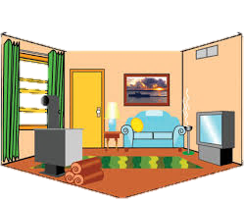

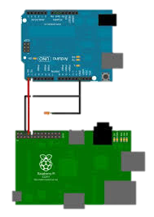
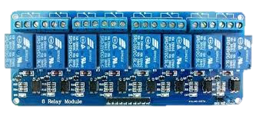

PROJECT OUTLINE
Android App
Various Room Appliances
Arduino
Web
Server
R-Pi
Relay Channel
App sends request to server ⇒ Database in server gets updated ⇒ Server sends response to R-pi ⇒ R-pi runs Arduino ⇒ Arduino controls the Relays ⇒ Relay acts as switch for the electrical circuit

Slide 4


Android App Development
Developed an android app which can send an HTTP request to our webserver and display the response.
Development in form of a list view consisting of toggle buttons for the appliances.
Achieved this using the Volley Library, an HTTP library that made networking faster.
The benefits offered are:
Automatic scheduling of network requests.
Cancellation request API - can cancel a single request, or can set blocks or scopes of requests to cancel.
Ease of customization, for example, for retry.

Slide 5
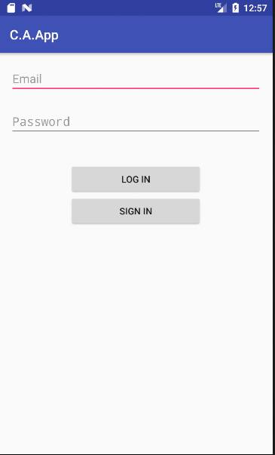
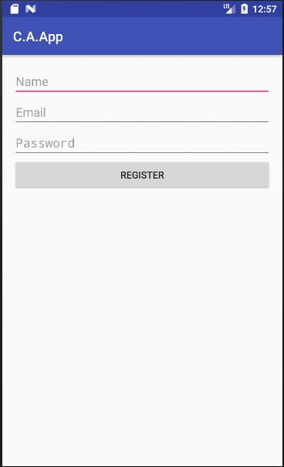
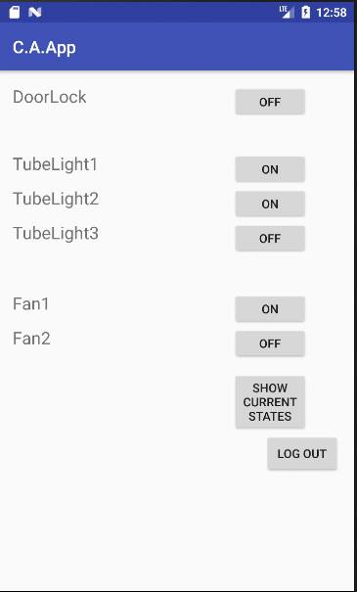
GUI (Graphic User Interface) of our app
The Login Page
The Sign Up Page
The Control Page
Not included in the current project

Slide 6


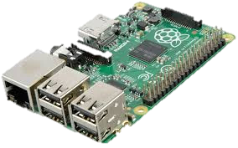

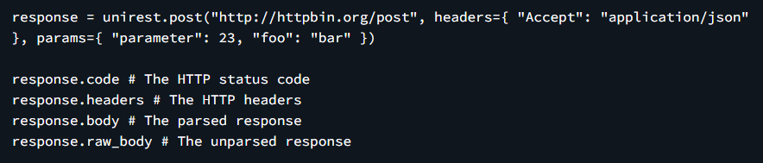
WEB server and r-pi

The Raspberry Pi is a small single board complete Linux computer. We use it as a control system
A web server is a computer system that processes requests via HTTP.
We have:
>Successfully created a local database and server. The database gets updated when a request is sent to the server through the R-Pi which is operated through terminal by installing Raspbian OS.

Slide 7
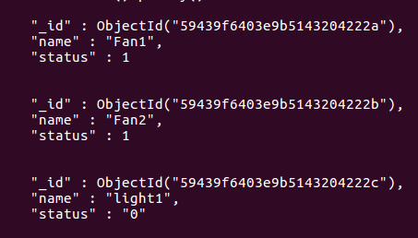
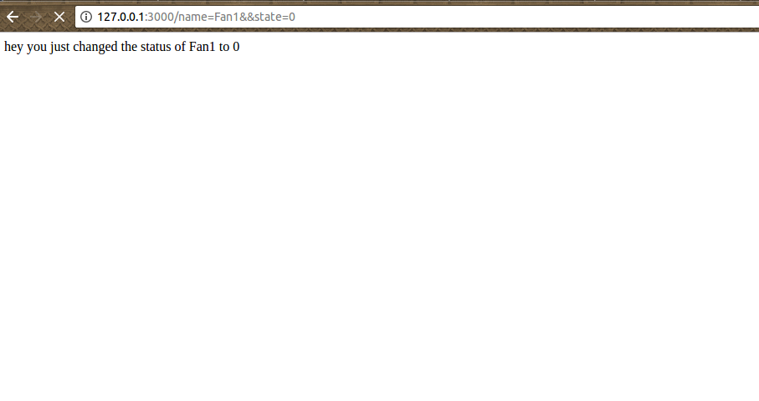
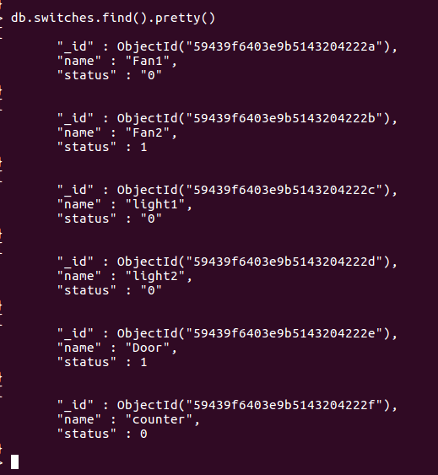
Working of Server
Initially the state of Fan was
1 == ‘ON’
Server gets a request from the user to turn off Fan1
The state of Fan1 changes from
1 to 0 in the database i.e. now
the fan is turned off

Slide 8
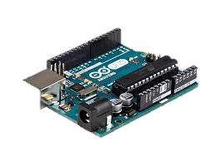
Relay module and Arduino
Arduino is an open source single-board microcontrollers for building digital devices and interactive objects that can sense and control objects in the physical world.
A relay is an electrically operated switch, which when connected to OS like Arduino or At-Mega, can be used to automate electric circuits which switch on and off on simple binary commands through connected web server.

Slide 9
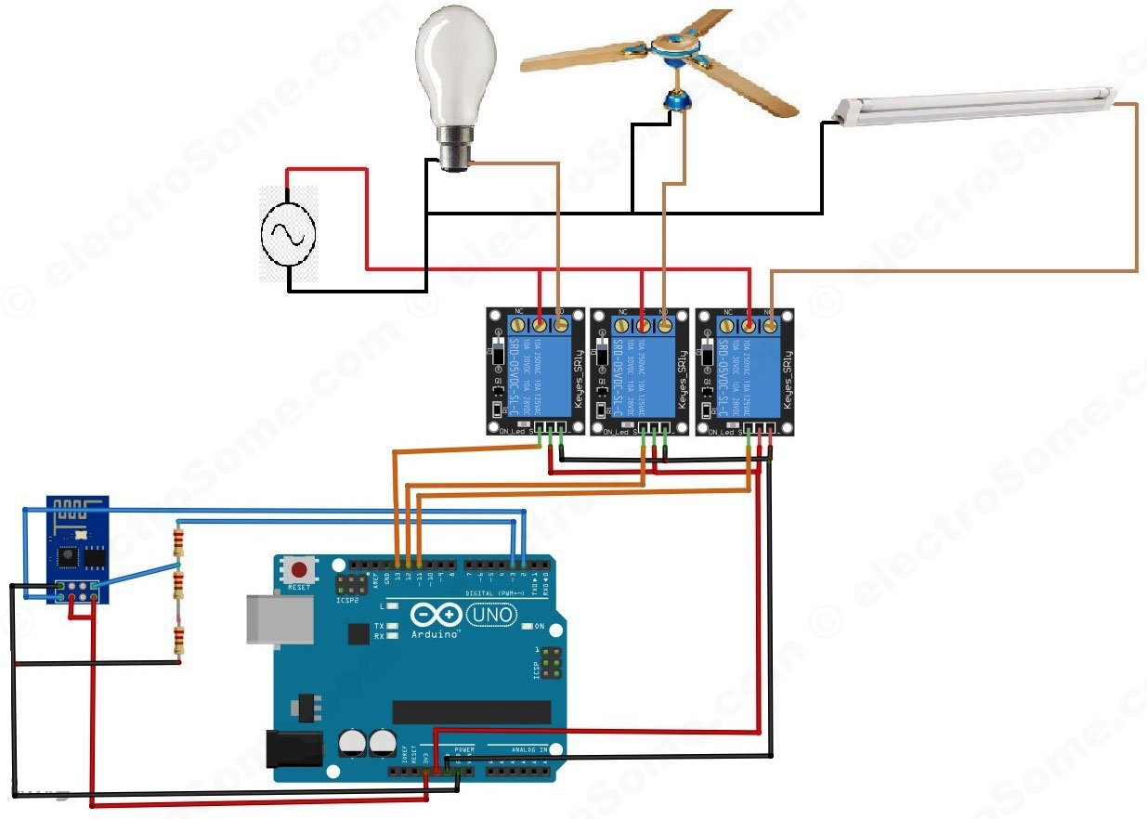
Using an operating system, we program the Arduino to control the relay. The lights and fans are connected to the relay and thus can be switched on/off on command of a single button.

Slide 10
PROJECT DEMO VIDEO
Please Click the Link to see the demo video of the project.
If all queries are satisfied, we can take the project to the next level and connect the actual appliances in the club room.
LINK TO VIDEO

Slide 11
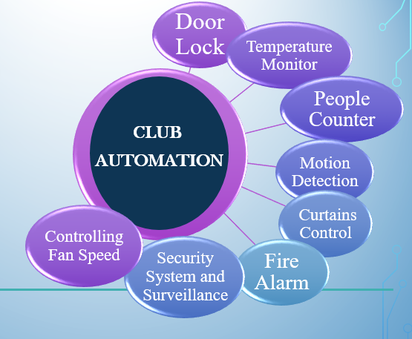
Future Aspects
Of
The project
Door Lock
Temperature Monitor
People Counter
Motion Detection
Curtains Control
Fire Alarm
CLUB
AUTOMATION
Controlling Fan Speed
Security System and Surveillance

Slide 12


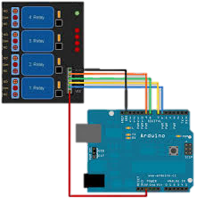
TEAM MEMBERS
Android App
R-pi & Web Server
Relay Circuit & Arduino
Subham Kumar Garvit Airen Shruti Shukla
Rahul Chauhan Sagar Chaudhary
Jeevan Kumar
Mentors: Amit Saharan Saurabh Ranjan Akash Gupta Akash Jain Ujjwal Varshney

Slide 13
Any Questions?

Slide 14

The End
Thank You

